Slide 1
Large Scale Data Science
Final Project
Mehdi Mezghani
Thomas Srour
Killian Hinard
Kamil Mellouk
Rémi Oddon
Étienne Bruno
Lausanne - Spring 2023

Slide 2
Outline
Data pre-processing
Network building
Path-finding algorithm
Delay statistics
Path success probability
Validation
Demonstration

Slide 3

Data
Pre-processing

Slide 4
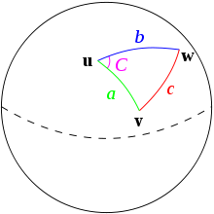
Initial assumptions
Timetables of the week of April 17th 2023 is the basis of our model
Only services that operate on every weekday are considered
Only stops within a 15 km (±20%) radius of Zurich HB are considered, using the Haversine distance. If needed stops may be reached via transfers through other stops outside the 15km area
We allow a maximum of 500m walking distances for transfers between two stops
We assume a walking speed of 50m/1min on a straight line, regardless of obstacles
We allow a maximum trip duration of 3 hours, adjustable by the user
Notes:
announced on april 12th, no bank holidays

Slide 5
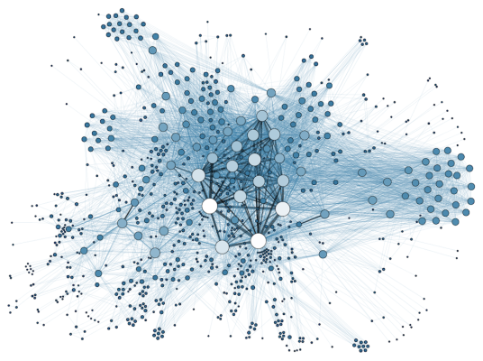
Network Building

Slide 6
Building the Nodes and the Edges
Each stop is represented as a node of the Graph, and each edge is a way of getting from one node to another.
We distinguish three types of edges:
Transport edges
Same station edges
Walking edges (max 500m)
We then join all the types of edges to get a graph, and fill trip ID, start and stop times for same station and walking edges with None.
Walking Edge
Zürich, Kreuzplatz
Zürich, Stadelhofen
Zürich, HB
Same station edge
Egg
Zürich, Flughafen
Zürich, HB

Slide 7
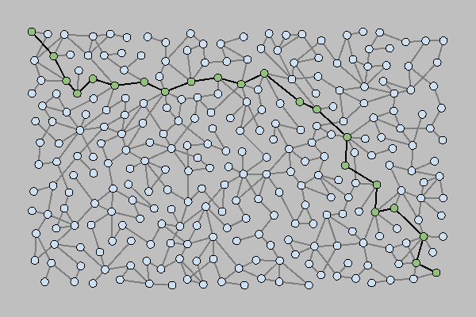
Pathfinding
Algorithm
key points

Slide 8
All edges Dataframe
Edges of interest
Weighted graph with travel times
without start and end time constraints
CP
CP
CP
CP
CP
VG
VG
VG
VG
VG
FP
FP
FP
FP
Filtering
P
P
P
Parameters:
Edges dataframe
Source
Sink
Desired arrival time
Maximum path duration
High level procedure:
Filter edges with respect to time constraint
Using Yen’s algorithm we determine the 100 best (i.e. shortest) paths, regardless of departure or arrival times
Check the feasibility of these paths when taking departure and arrival times into account
Add all feasible paths to a list
Filter them with path characteristics

Slide 9

Delay Statistics

Slide 10
Delay Statistics
Estimation of success probability for a path :
=> We need to estimate the average delay at each stop on the previous real data
Processing on Istdaten table :
Only nodes in Zurich
Dropping additional journey
Dropping path that failed
Dropping nodes where the mean of transport didn’t stop
Keep only the data for the week days
Keep only data with an actual arrival time

Slide 11
Delay Statistics
Computing Delays at each stop :
=> delay = (actual arrival time) - (scheduled arrival time)
We made the decision to not take into account the transport that arrive in advance (more details in the data visualization part) :
=> we clip the negative delay to zero
We will use the hour of the scheduled arrival time to have a better estimation of the average delay
=> we add the hour of the arrival time to the table

Slide 12
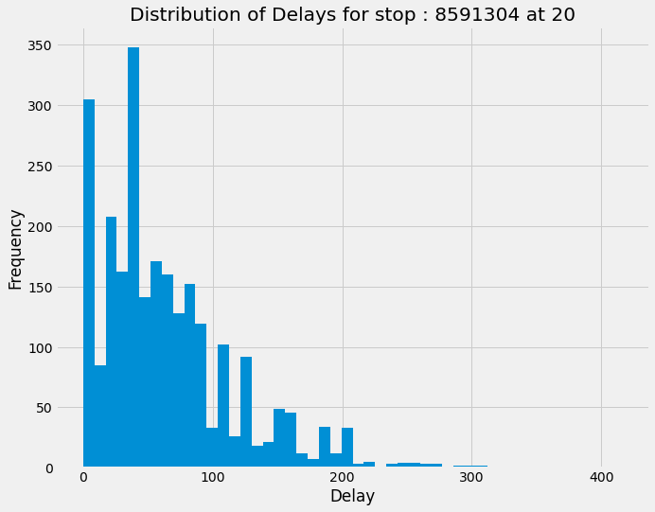
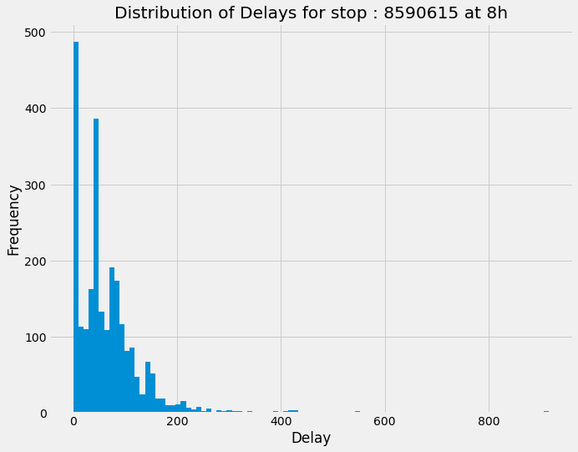
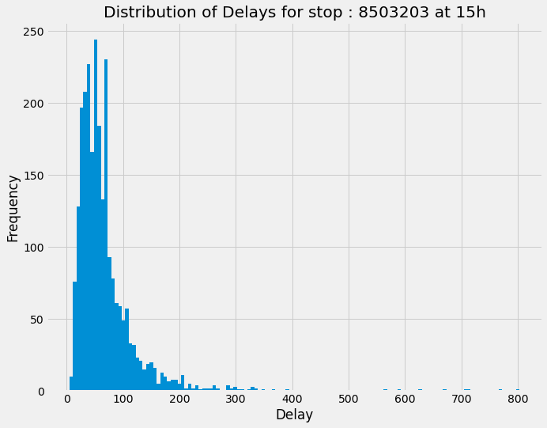
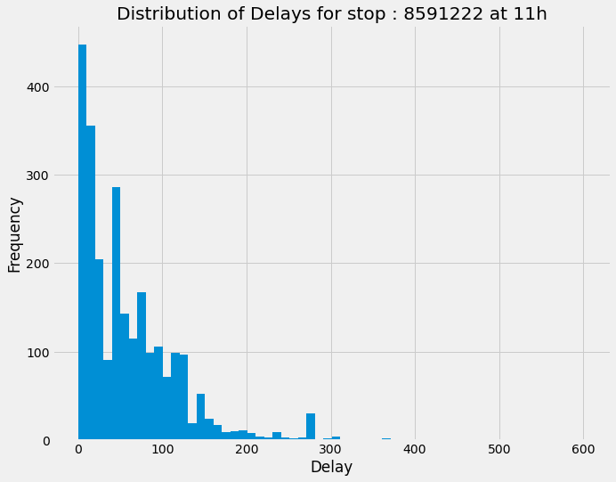
Data Visualization
What probabilistic model should we use ? :
Plot delays of random stop and hour
=> Exponential distribution seems reasonable

Slide 13
Delay Statistics
Computing the average delay at each stop :
Assumptions : delay correlated to the stop location and the hour of the day
Group by clean istdaten by stop
Group by clean istdaten by hour
Compute the mean
 | stop_id | hour | avg_delay
 | 8576200 | 12 | 69.168516
 | 8502275 | 3 | 145.416667
 | 8590521 | 10 | 87.307128
 | 8583756 | 7 | 125.172066
 | 8588314 | 5 | 12.450654
Create the new table isdt_clean_mean selecting the columns stop_id, hour and avg_delay and save it to hdfs
sample of the final table

Slide 14

Path
Success Probability

Slide 15
Path Success Probability
Estimation of success probability for a path :
a path is composed of trips each composed of edges
connections are when we’re changing trip
each trip are considered independent
=> probability of successful path : p1 * p2 * … * pn-1
with pi is probability of making the connection between trip i and trip i+1
We need to :
Go through every edges in the path
When connection estimate the probability using exponential distribution
return the total probability
walking trip are not consider as a connections

Slide 16
Path Success Probability
Example of path with 4 trips, 5 stops and 2 connections :
Trip 1
Trip 2
Free time = (start time 3) - (stop time2)
Walking trip
Trip 3
stop time 1
start time 2
Walking time
S1
S2
S3
S4
S5
Free time = (start time 2) - (stop time 1) - (walking time)

Slide 17

Validation

Slide 18
Probability validation
For each path, we compute the path success probability and compare it to the probability of finding delays smaller than the free time for each connection filtering by the stop and the hour of that connection.
We need to :
Go through every edges in the path
When connection estimate the probability using past data
return the total probability
walking trip are not consider as a connections

Slide 19
Probability validation
Prediction | Validation
11% | 16%
57% | 60%
55% | 59%
76% | 82%
97% | 97%

